Slide 1
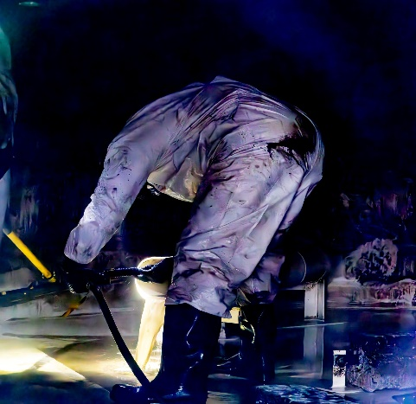
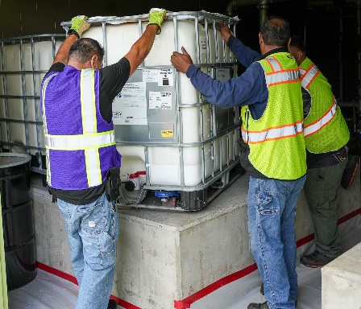
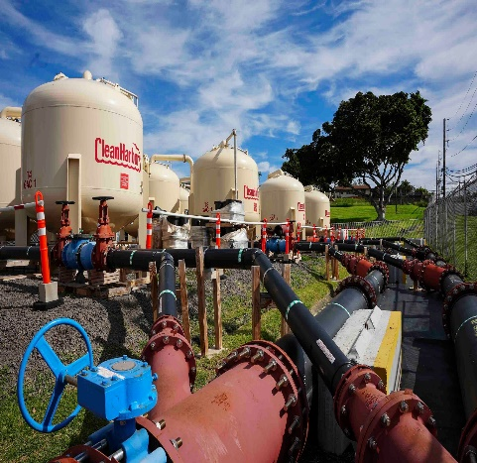
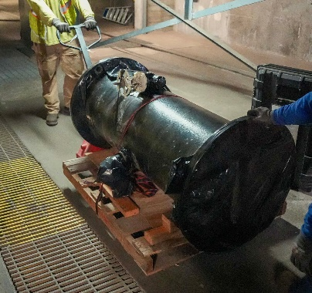
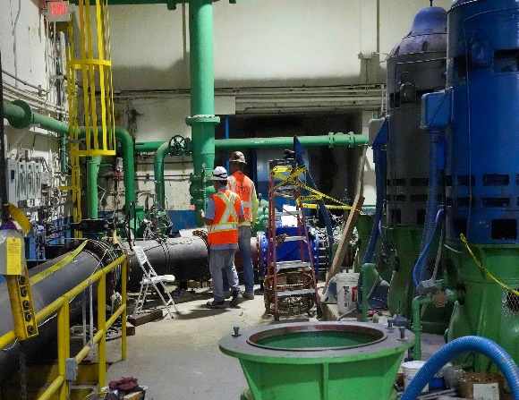
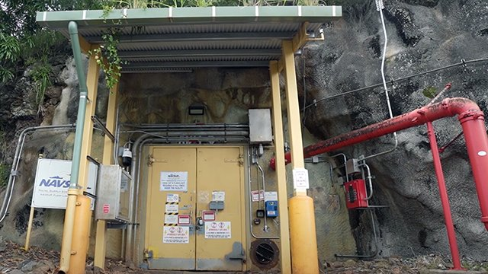
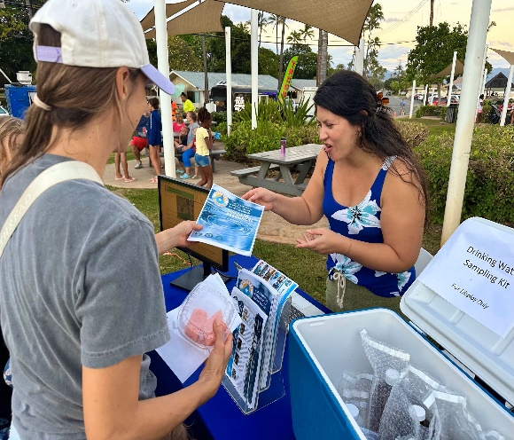
NCTF-RH Mission
Decommission Timeline:
AFFF Removal
Tank Cleaning
Pipeline Removal
CY 24
CY 25
CY 26
CY 27
CY 28+
Ongoing:
Environmental & Remediation
Strengthening Water Resiliency & Continuing Safe Drinking Water
Environmental Monitoring & Modeling
Site Assessment & Remediation
Communication
Persistent Stakeholder Engagement Through Multiple Channels
Website, Mobile App & Dashboard
Drinking Water
Info Booths
Government / Community Meetings
Open Houses
Neighborhood Boards
Vodcasts / Webinars
1
Notes:
COS:
[COS SHARE A LITTLE ABOUT HIS BACKGROUND, PRIOR CONNECTION TO HAWAII.]
SINCE WE HAVE A COUPLE OF NEW COMMISSIONERS – WE WANT TO PROVIDE SOME BACKGROUND FOR YOU.
FOLLOWING THE NOVEMBER 2021 RELEASE – JOINT TASK FORCE-RED HILL WAS STOOD UP IN THE FALL OF 2022 TO DEFUEL THE FACILITY.
THEY SUCCESSFULLY REMOVED OVER 104 MILLION GALLONS OF FUEL VIA GRAVITY FROM THE FACILITY.
WE OFFICIALLY TOOK OVER FROM JTF AT THE END OF MARCH 2024 AND OUR MISSION TIMELINE – AS IT STANDS NOW – TAKES US THROUGH 2028.
ON THE SCREEN IS AN OVERVIEW OF NCTF-RH OPERATIONS, WHICH REVOLVE AROUND THREE LINES OF EFFORT:
DECOMMISSIONING (CAPT ROBERT KLEINMAN, DIRECTOR OF DECOMMISSIONING) WHICH INCLUDES THREE KEY ACTIVITIES, REFLECTED ACROSS THE TIMELINE
THE OVERALL SAFE AND PERMANENT DECOMMISSIONING OF THE FACILITY TO PREPARE IT FOR CLOSURE.
WE’VE ALREADY COMPLETED AQUEOUS FILM-FORMING FOAM OR A-TRIPLE-F REMOVAL AND WE ARE NOW ON TANK CLEANING AND ARE PREPARING FOR PIPELINE REMOVAL
BELOW THE TIMELINE, ARE THE LINES OF EFFORT THAT WILL BE SUSTAINED AND EXIST AS PART OF OUR ONGOING COMMITMENT
ENVIRONMENTAL AND REMEDIATION (CDR BENJAMIN DUNN, DEPUTY FOR ENVIRONMENT & REMEDIATION):
DESCRIBES THE LONG-TERM ENVIRONMENTAL CLEAN-UP AND PROTECTIVE ACTIONS THE NAVY HAS BEEN TAKING AT RED HILL.
FUTURE INITIATIVES ARE INFORMED BY PUBLIC, AGENCIES AND RESPECTIVE STAKEHOLDER COMMENTS.
COMMUNICATION:
WE ARE COMMITTED TO KEEPING AN OPEN LINE OF COMMUNICATION WITH THE PUBLIC AND STAKEHOLDERS THROUGH VARIOUS MEANS, AS WE PERFORM WORK TO CLOSE AND DECOMMISSION THE RED HILL FACILITY.
AS YOU CAN SEE – THE ENVIRONMENTAL & REMEDIATION AS WELL AS THE COMMUNICATION LINES OF EFFORT EXTEND BEYOND CALENDAR YEAR 2028, AS THEY ARE ONGOING AND ENDURING EFFORTS.
NOW I’LL TURN IT OVER TO CAPT ROBERT KLEINMAN, FOR DECOMMISSIONING UPDATES – NEXT SLIDE, PLEASE.
*COS UPDATED TPS 1340 11MAR2026

Slide 2
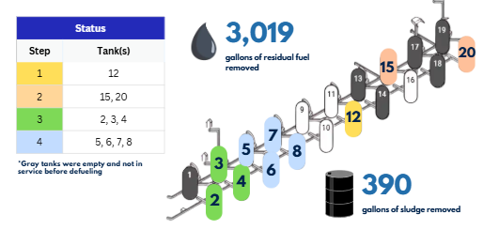
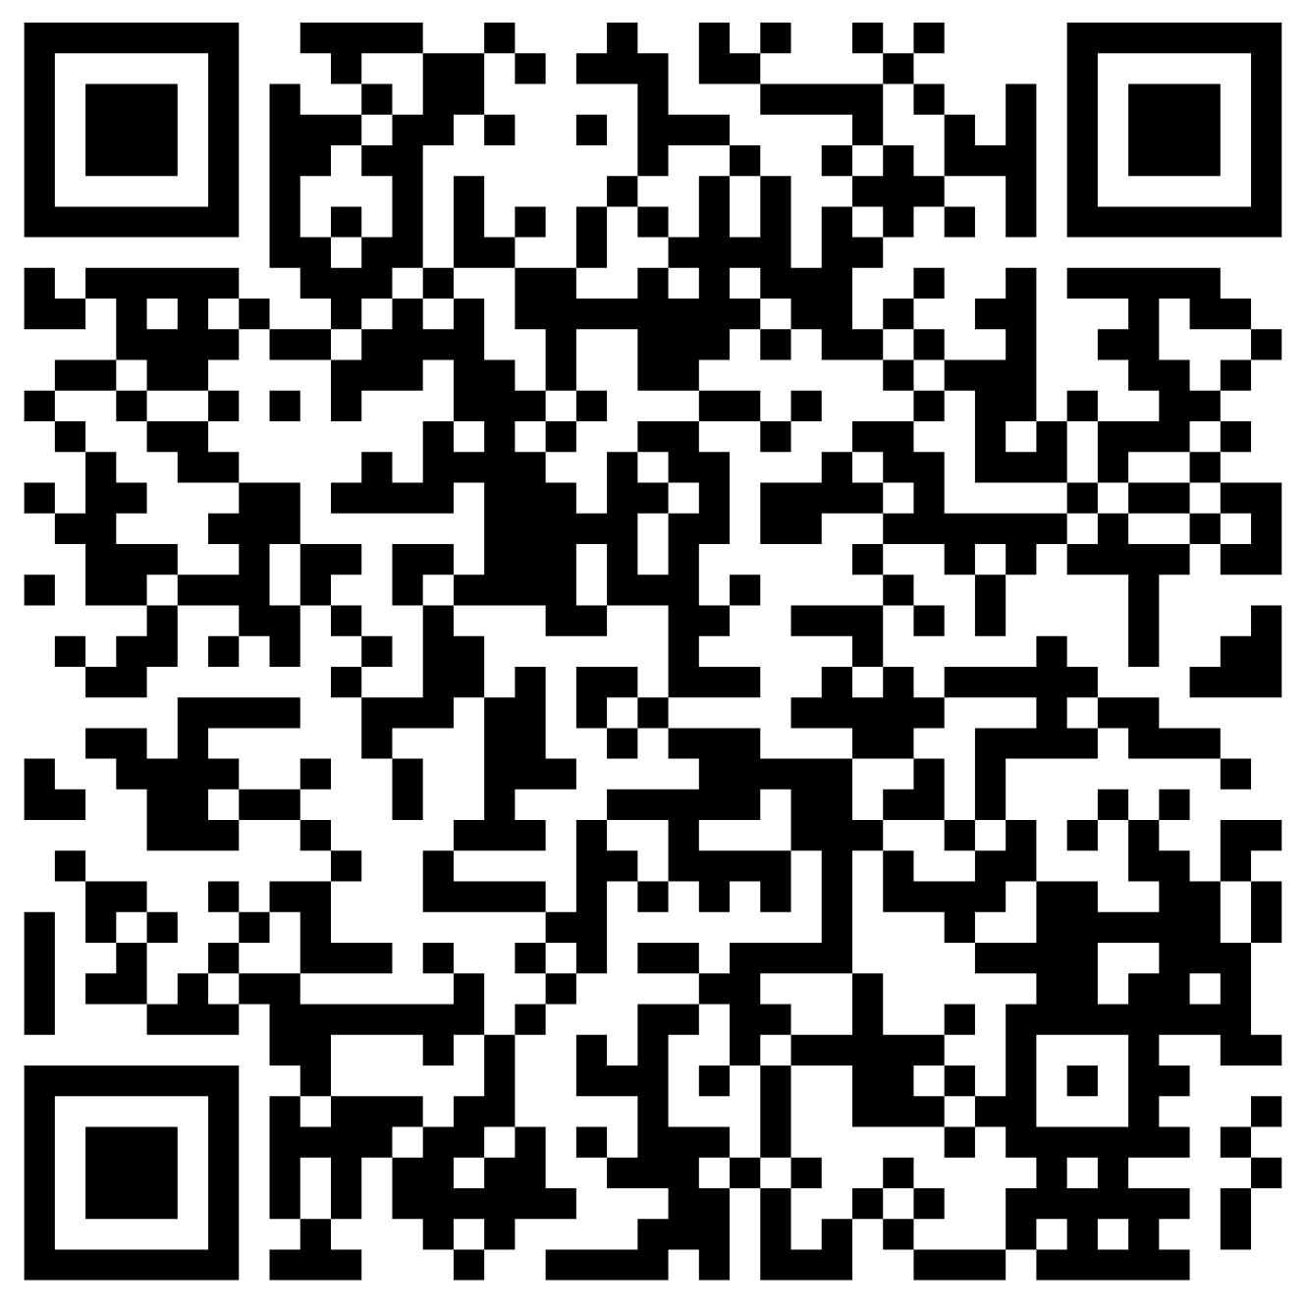
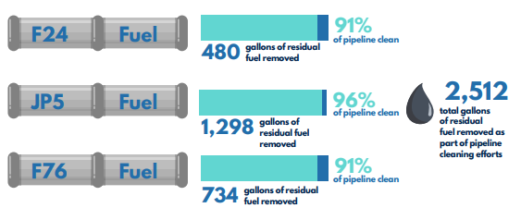
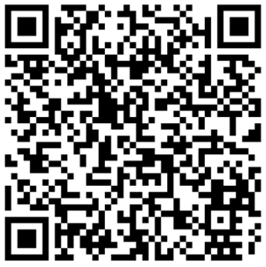
Red Hill Bulk Fuel Storage Facility Decommissioning
Information current as of 27 MAR 2026
Tank Cleaning
Pipeline Cleaning
Notes:
CAPT KLEINMAN:
SINCE OUR LAST FTAC UPDATE IN OCTOBER OF 2025 – WE’VE REACHED SEVERAL MILESTONES IN OUR MISSION.
THE BOTTOM LINE REMAINS – NAVY CLOSURE TASK FORCE-RED HILL IS ON PLAN FOR THE CLOSURE AND DECOMMISSIONING OF THE RED HILL BULK FUEL STORAGE FACILITY PER REGULATOR-APPROVED PLANS AND SCHEDULES.
THIS IS ONE OF TWO DASHBOARDS WE USE TO GRAPHICALLY SHOW PROGRESS WITH OUR DECOMMISSIONING EFFORTS, WITH THIS ONE SHOWING OUR PROGRESS WITH TANK CLEANING AND OUR SECOND ONE SHOWING THE PROGRESS OF EFFORTS TO REMOVE THE FUEL PIPELINES, WHICH I WILL DETAIL IN THE NEXT SLIDE.
BOTH DASHBOARDS ARE REGULARLY UPDATED ON OUR MOBILE APP AND WEBSITE.
ADDITIONALLY, EACH DASHBOARD INCLUDES ITS OWN RUNNING COUNT OF RESIDUAL FUEL CAPTURED…AND THIS IS THE RESIDUAL FUEL WHICH DID NOT COME OUT DURING GRAVITY DEFUELING WHEN THE JOINT TASK FORCE-RED HILL DEFUELED THE NEARLY 104 MILLION GALLONS OF FUEL.
WHEN THE DECISION WAS MADE TO CLOSE THE RED HILL FACILITY, 14 OF THE 20 TANKS WERE IN SERVICE WITH FUEL. OF THOSE 14 TANKS, 10 OF THEM ARE IN THE CLEANING PROCESS. SO, WE’VE GOTTEN IN INTO TWO MORE TANKS SINCE WE LAST UPDATED YOU IN OCTOBER.
AS A QUICK REMINDER, TANK CLEANING IS A DELIBERATE FOUR STEP PROCESS, AND WHILE I WILL GO INTO SOME DETAIL…IF YOU’D LIKE MORE INFO ON WHAT IS INVOLVED IN EACH STEP…THE QR CODE ON THE SLIDE WILL TAKE YOU TO THE DASHBOARD, WHICH DETAILS EACH STEP.
STEP ONE IS THE PREPARATION PHASE. THE MAJOR ELEMENT OF THIS STEP IS TO CONDUCT A PROCESS KNOWN AS DEGASSING…WHICH IS WHERE WE VENTILATE THE TANK TO ENSURE IT IS SAFE FOR PEOPLE TO ENTER. LAST MONTH, WE STARTED DEGASSING TANK 12.
WHILE WE ARE ACTIVELY VENTILATING A TANK, WE POST AIR QUALITY MONITORING REPORTS HOURLY ON OUR MOBILE APP AND DAILY ON OUR NCTF-RH WEBSITE, WHICH REMAIN POSTED AND ARCHIVED.
SINCE WE STARTED VENTILATION OPERATIONS IN MAY 2024, THERE HAVE BEEN NO ELEVATED AIR QUALITY READINGS.
STEP TWO IS ABOUT GETTING THE TANK READY TO BE WASHED. THIS INCLUDES A STRUCTURAL INSPECTION OF THE INTERIOR COMPONENTS OF THE TANK, THE CENTER TOWER AND CATWALK, CONDUCTING NECESSARY REPAIRS IDENTIFIED DURING THE INSPECTION, THE INSTALLATION OF THE BOOMS WHERE PEOPLE WILL OPERATE THE PRESSURE WASHERS, AND THE REMOVAL OF ANY RESIDUAL SLUDGE FROM THE BOTTOM OF THE TANK WHICH DID NOT COME OUT WHEN WE GRAVITY DEFUELED IT.
OUT OF THE EIGHT TANKS WHERE WE HAVE REMOVED SLUDGE, WE HAVE CAPTURED ABOUT 390 GALLONS.
WE CURRENTLY HAVE TWO TANKS (2 AND 15) IN THIS STEP.
THE CLEANING OF THE TANK’S INTERIOR OR PRESSURE WASHING OCCURS DURING STEP THREE:
SO FAR, WE HAVE COMPLETED PRESSURE WASHING FIVE OF THE TANKS, WITH TWO TANKS BEING ACTIVELY WASHED, TANKS 2 and 4.
THE WATER WE USE TO PRESSURE WASH IS RE-DIRECTED WATER FROM OUR PUMPING OPERATIONS OUT OF THE RED HILL WELL… WHICH WOULD HAVE GONE INTO THE HALAWA STREAM… AND NOT ADDITIONAL WATER BEING TAKEN OUT OF THE AQUIFER.
PER A HAWAII DOH PERMIT – THE RINSATE OR WASH WATER USED TO CLEAN THE TANKS IS TESTED FOR A FULL SPECTRUM OF ANALYTES FOR WASTE CHARACTERIZATION PRIOR TO PROPER DISPOSAL.
STEP FOUR INVOLVES OBTAINING REGULATOR CONCURRENCE, AND THEN DEMOBILIZATION. CURRENTLY THERE ARE FOUR TANKS IN THIS STEP, TANKS 5, 6, 7 AND 8.
NEXT SLIDE, PLEASE.
*C. PASCUAL UPDATED TPS 0840 18MAR26

Slide 3
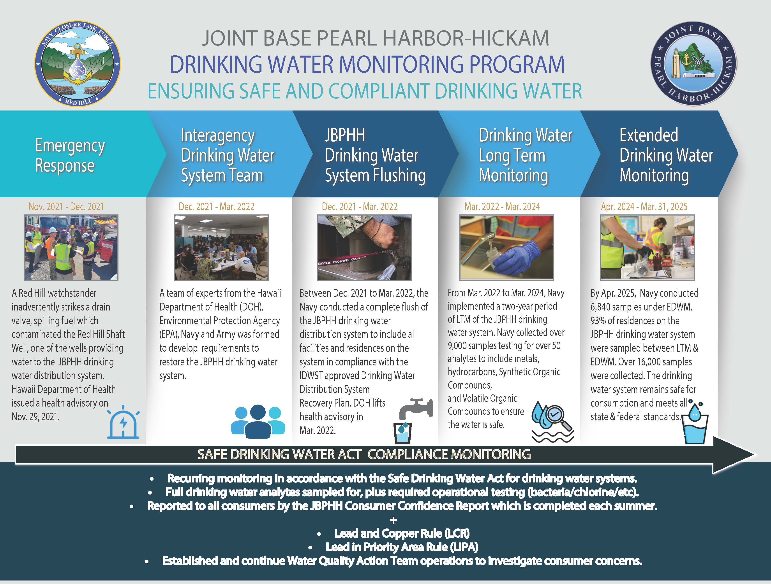
3
Notes:
CDR DUNN:
*CDR DUNN UPDATED TPS XXMAR26

Slide 4
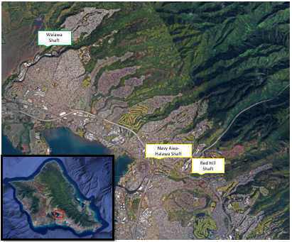
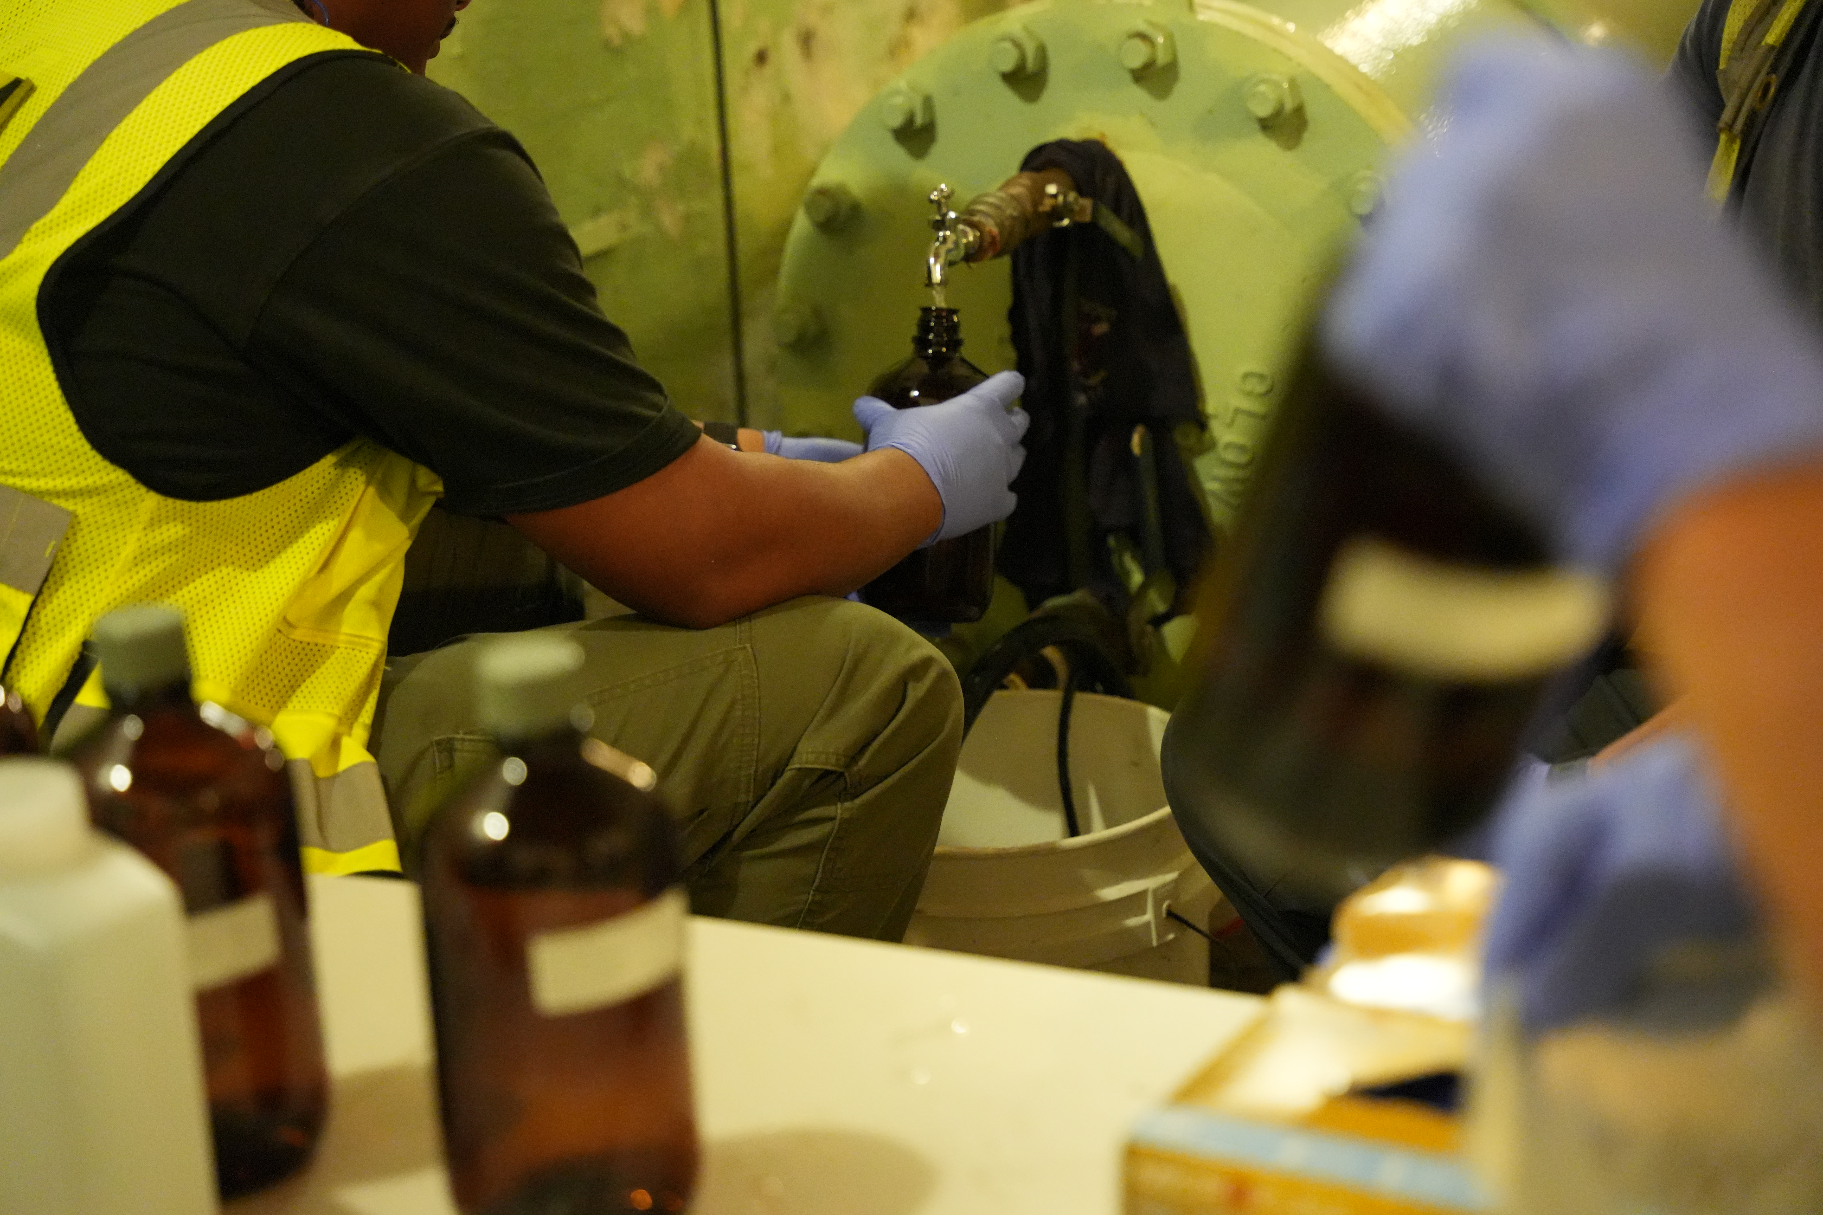
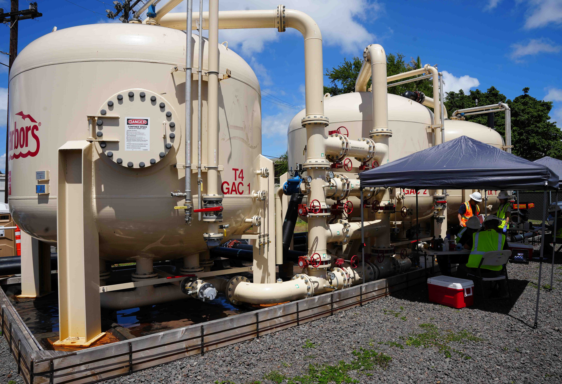
Navy Aiea-Halawa Shaft Reactivation
Overview
Smallest of three JBPHH drinking water production wells
Isolated from system since Dec 2021
Important asset supporting JBPHH water system resiliency
Extensively monitored
Proactive installation of onsite treatment system to address PFAS, well in advance of 2029 drinking water compliance
DOH Emergency Use Requirements
DOH Approval,
Notice, Reactivation
NAHS Well Secured
Reactivation Plan Submission
Navy Reactivation Request
DOH Conditional Approval
Additional Evaluation of Treatment System
Final Site &
System Preparations
DOH Inspection
GAC Installation
Monitoring Pilot
Post-Reactivation
Monitoring
Dec 2021
Aug 2022
Jul 2023
Apr 2024
Oct 2024
Feb 2025
Apr-May 2025
Fall 2025
Jan-Mar 2026
2026
Communication
NCTF-RH open houses
Stakeholder engagements
Drinking water Info Booths
Red Hill Highlights
Vodcasts
Public webinars
JBPHH-Safewaters website
NCTF-RH website
DOH, EPA, CWRM notice
Notice to residents, consumers
4

Slide 5
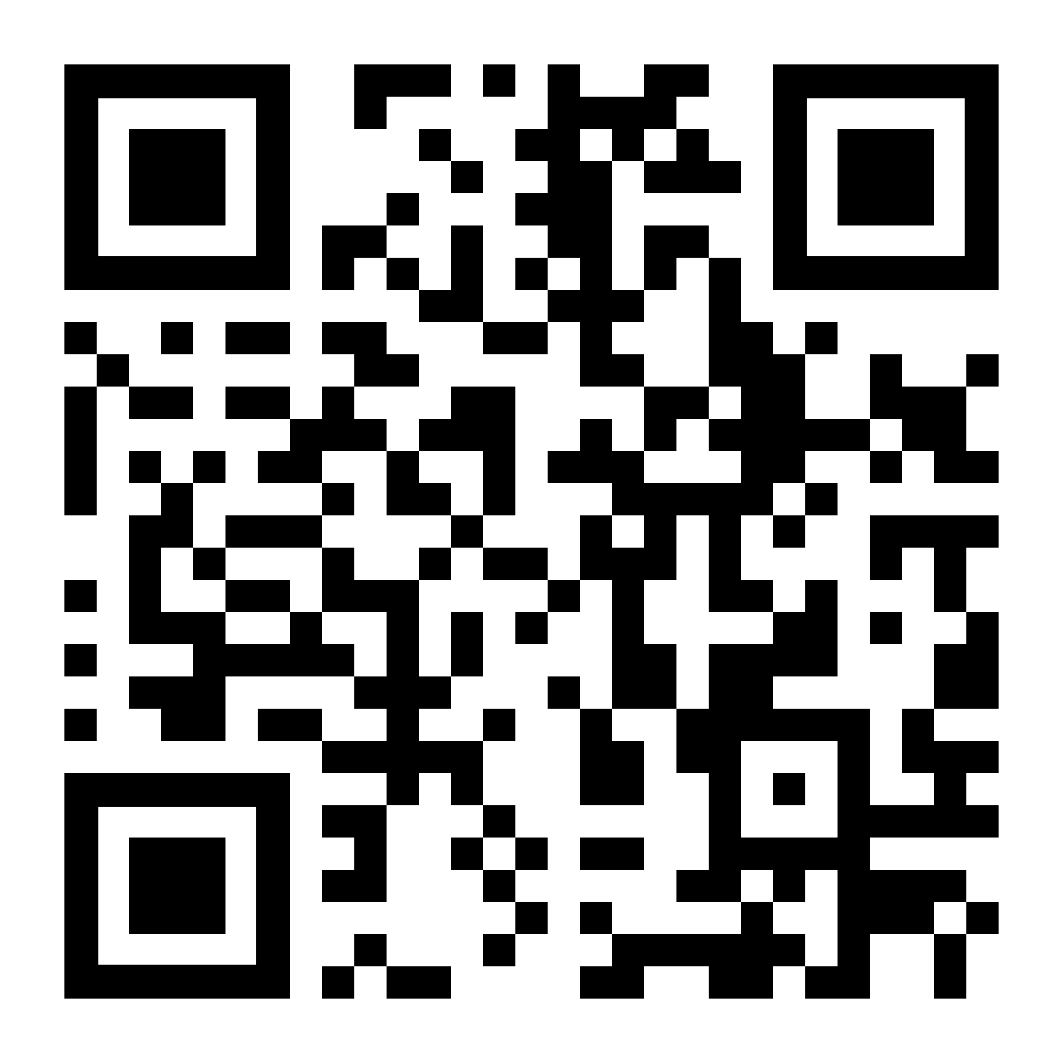
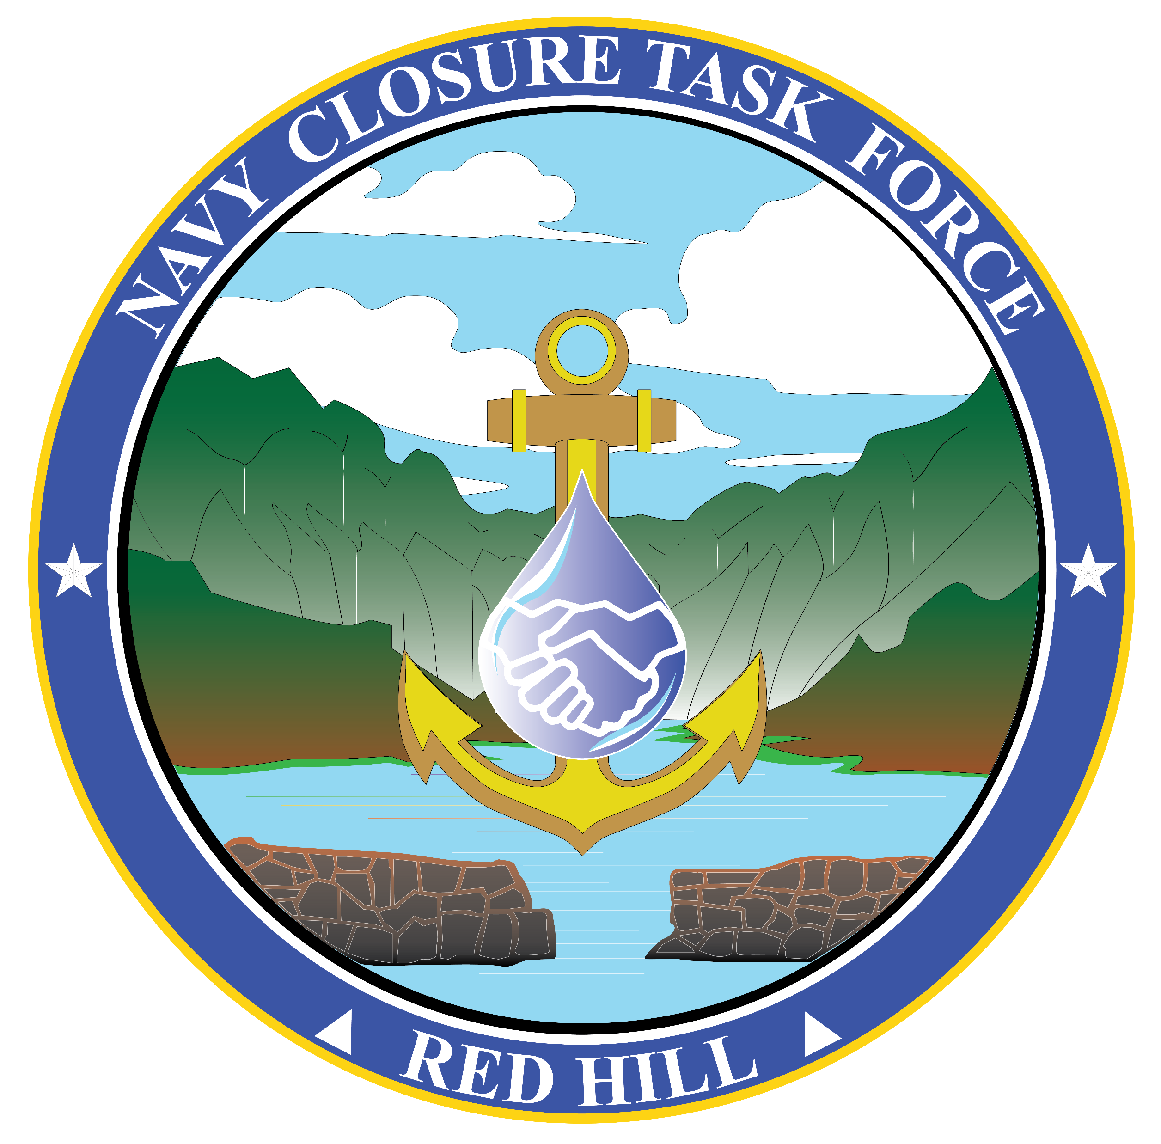
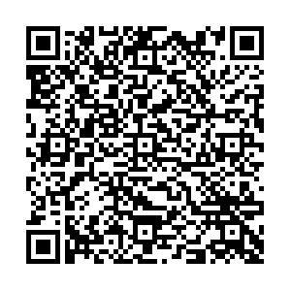


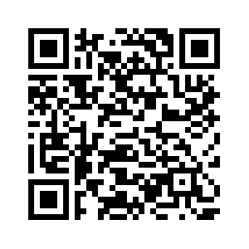
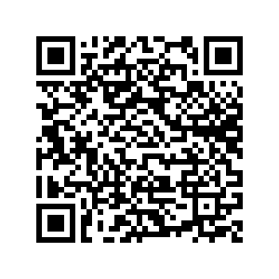


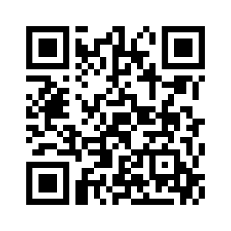

Resources
Navy Closure Task Force–Red Hill
navyclosuretaskforce.navy.mil
Document library for defueling & closure of Red Hill Bulk Fuel Storage Facility
Photos & media gallery
Upcoming public engagements
Red Hill Highlights
Joint Base Pearl Harbor-Hickam Safe Waters
jbphh-safewaters.org
Environmental data & plans
Drinking water monitoring test results
Groundwater monitoring test results
Red Hill remediation actions schedule
Download the free NCTF-RH app
Interactive progress dashboard
Latest news
Photos & videos
Presentations & fact sheets
Air quality monitoring data
“Let’s Talk Red Hill” Podcast
youtube.com/@NCTF-RH
Updates and information regarding the closure of the Red Hill Bulk Fuel Storage Facility
Notes:
DCOM:
AS WE’VE SHARED BEFORE, WE HAVE NUMEROUS RESOURCES WHERE THE PUBLIC CAN FIND MORE INFORMATION ABOUT THE CLOSURE TASK FORCE'S ACTIVITIES.
ON OUR WEBSITE YOU CAN FIND:
LINKS TO OUR DOCUMENT LIBRARY AND OUR RED HILL HIGHLIGHTS NEWSLETTER
PHOTOGRAPHS AND INFORMATIVE VIDEOS
A LIST OF OUR UPCOMING PUBLIC ENGAGEMENTS
ALL OF OUR WEBINARS ARE RECORDED AND POSTED ON OUR YOUTUBE PAGE.
THE JOINT BASE PEARL HARBOR-HICKAM’S SAFE WATERS WEBSITE INCLUDES:
COMPREHENSIVE ENVIRONMENTAL DATA AND PLANS
DRINKING WATER AND GROUNDWATER MONITORING TEST RESULTS
OUR REMEDIATION ACTIONS SCHEDULE – AND MUCH MORE
THERE ARE ALSO QR CODES TO DOWNLOAD OUR APP WHERE YOU CAN FIND:
THE DASHBOARDS WE SHOWED YOU IN PREVIOUS SLIDES - WHERE YOU CAN FOLLOW OUR PROGRESS – EVEN DOWN TO THE DETAILS FOR EACH INDIVIDUAL TANK.
OUR “LET’S TALK RED HILL” PODCAST
THESE EPISODES ARE FAIRLY SHORT – RUNNING AN AVERAGE OF FIVE TO SEVEN MINUTES LONG EACH – DETAILING DIFFERENT PARTS OF OUR MISSION AND MILESTONES.
THE BOTTOM LINE IS THAT OUR COLLECTION OF COMMUNICATION PRODUCTS IS GUIDED BY FEEDBACK WE RECEIVE FROM THE PUBLIC AS WELL AS FROM STAKEHOLDER ENGAGEMENTS LIKE THIS ONE.
THANK YOU AGAIN FOR ALLOWING US TO PROVIDE AN UPDATE AND I LOOK FORWARD TO CONTINUING TO WORK WITH YOU ALL AS OUR MISSION CONTINUES.
WE’LL STANDBY FOR QUESTIONS.
*C.PASCUAL UPDATED TPS 0816 25MAR26

